Slide 1


The Value of Membership
Tampa Bay Area Chapter of NIGP
Joe Benjamin CPPO, CPPB - March 26, 2021

Slide 2
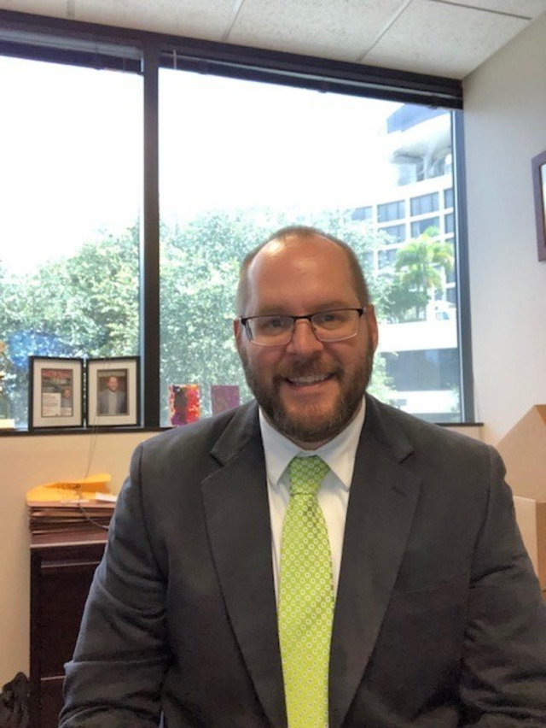



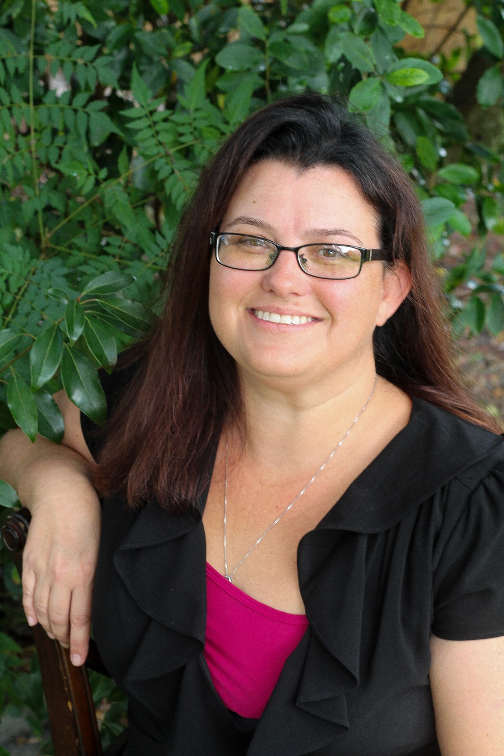
The Executive Board
James Hanney
President
Tampa International Airport
Celeste Gibbons-Peoples
Vice President
City of Tampa
Stacy Gundry
Treasurer
Tampa Bay Water
Stephanie Swinson
Secretary
City of St. Petersburg
Tara Camp
Past President
Tampa International Airport

Slide 3



The Special Committee Board
Stephanie Bunford
Communications Chair
Pasco County Schools
Cheryl Aldridge
Professional Development
Chair
City of Tampa
Mina Kaeding
Programs Chair
Hillsborough County Schools

Slide 4

The Chapter’s Mission
To promote excellence in public procurement through education, certification and technical assistance for those who spend governmental funds in the Tampa Bay Area.
Core Concepts
Collaboration - working collaboratively and providing impartial support to all members.
Responsibility - dedication and loyalty to our mission and purpose as a chapter
Teamwork - building on our common backgrounds and shared interests to the benefit of all members
Inspiration - inspiring our members to achieve excellence in everything they do
Recognition - acknowledging the efforts and accomplishments of all who volunteer their service.

Slide 5

Membership Types
Chapter Member - $35 a year
Retired Member – Free
Student Member – Free
Honorary Member – Free

Slide 6
PROFESSIONAL DEVELOPMENT
Member-only discounts for educational opportunities and bi-monthly luncheon meetings with diverse and dynamic topics and speakers
Earn nationally recognized continuing education unit (CEU) credits and certification/recertification hours
Certification financial assistance
Earn scholarship points that can be redeemed for attendance to conferences, workshops, and educational seminars
Opportunities for recognition for excellence through the Buyer of the Year, Manager of the Year and other awards programs
Networking opportunities with other professionals from throughout the Tampa Bay area and across the country
FREE access to our quarterly newsletter covering information specific to government procurement professionals

Slide 7
Education
40% subsidy on NIGP courses sponsored by the Chapter
  Estimated savings on 2-day course is $200
Certification Study Groups
Centrally located
Calendar of Events
NIGP - Special Savings
You win by getting exclusive savings of $50 on select virtual offerings. NIGP has reduced prices on numerous virtual classes so you can keep learning and growing.
Our chapter wins by earning a 15% rebate for every member who registers before June 30, 2021.

Slide 8

Engaging with Bay Area Professional Peers
Quarterly luncheons
  Rusty Pelican Restaurant
    11:00 am – 1:00 pm
    Educational Speakers
    $15.00
MemberConnect
  MemberConnect@list.nigp-tampabay.org
  Member Directory
  Volunteer Opportunities
TS and RTS Events
  Meet new suppliers
  Meet members
Local Career Opportunities
  https://www.nigp-tampabay.org/insidepages/jobs/

Slide 9
Scholarship Opportunities
Attendance at all luncheons
Golf Tournament Sponsorships
Hold UPPCC or NIGP Certification
Member of NIGP National = 10 points
Teach a Chapter or Public Procurement Workshop
Serving as committee chair, co-chair or committee member
Serving as a Chapter Offficer
Volunteering at chapter events, seminars and fundraising activities

Slide 10

Using my Scholarship
NIGP Pathways classes and seminars
NIGP's National Forum and Trade Show
Annual FAPPO Conference and Trade Show
Certification Prep Classes
NIGP-FAU Learning Certificate courses

Slide 11

Scholarships in 2019
$50,846 awarded to members for 2019
  3 FAPPO Scholarships
  6 NIGP Course Scholarship
  22 NIGP Forum Scholarships
  2 Other Procurement related Conference Scholarships
First Timer’s Scholarship

Slide 12
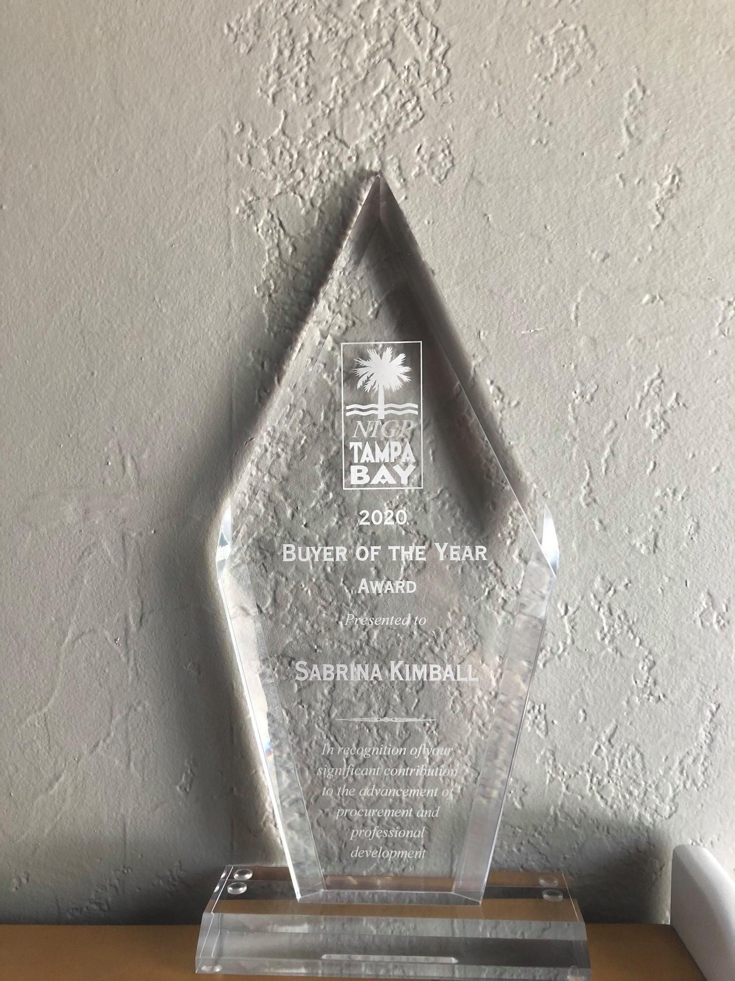
Chapter Awards
Buyer of the Year
Manager of the Year
Volunteer of the Year
Warren Geltch Leadership Award
*All awardees receive a plaque and cash award

Slide 13

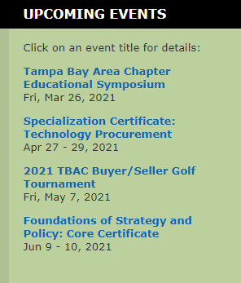

Slide 14


Slide 15


